Slide 2
Czech Republic in general
10,5 million inhabitants
Located in Central Europe, rich history and culture since the middle ages
Very friendly cost of living
8th safest country in the world
Cradle of genetics, contact lenses, water turbine, blood types, nanofibers and many more (including sugar cubes and lager beer).

Slide 3
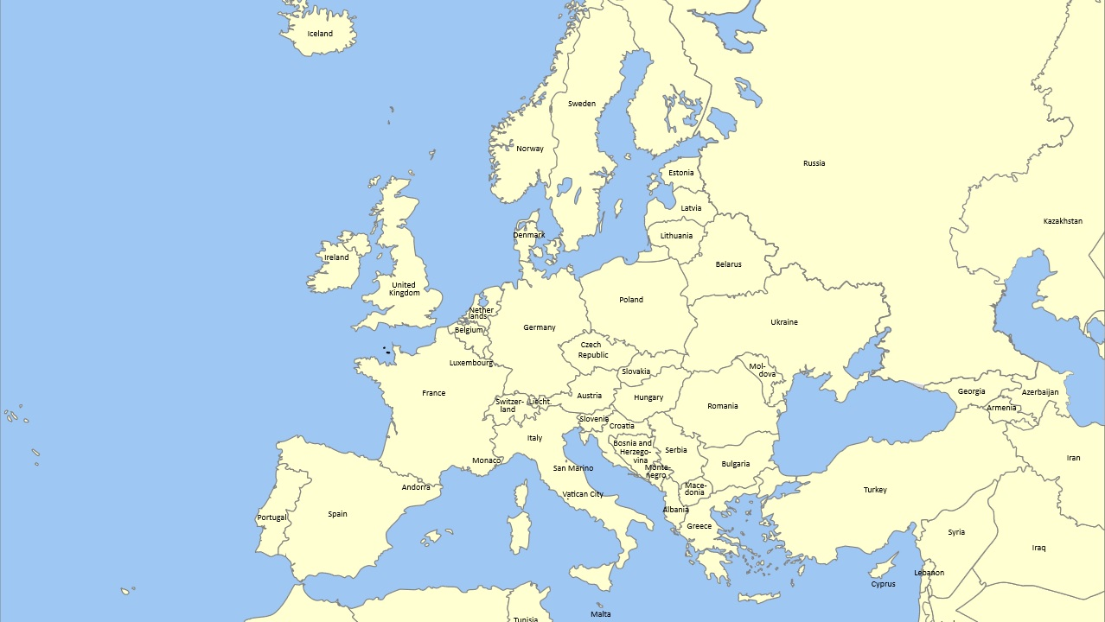

Slide 4
Faculty of Arts
Founded in 1919
The largest MU faculty
Traditional humanities-oriented disciplines
Growing number of programs taught in English
E-sources

Slide 5
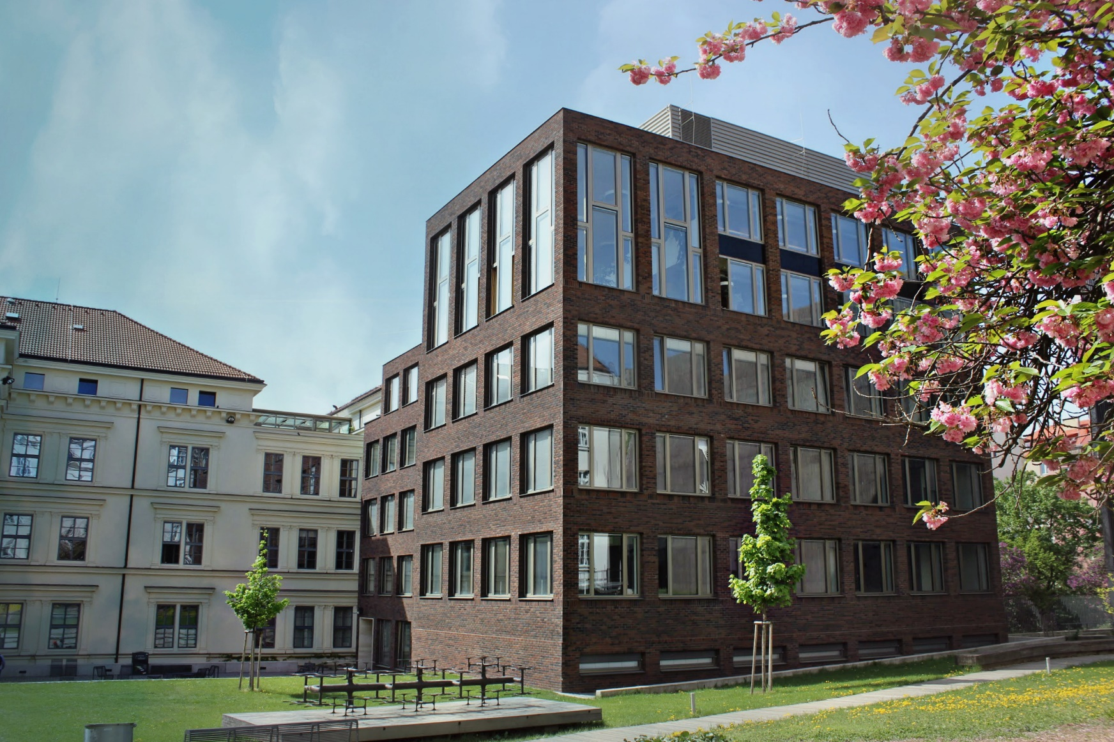
Faculty of Arts
Philology
Historical Sciences
General Theory and History of Arts and Culture
Humanities
Psychology
Pedagogy

Slide 6
Faculty in Numbers
6,500 students in Czech programs
Faculty Library
816 000 books
200+ Courses in English
27 Departments
150 Research projects
150+ Foreign instructors each year

Slide 7
Number of Programs
BA study programs
MA study programs
PhD study programs
In Czech
Full-time: 45
Part-time: 13
In English
Full-time: 2
In Czech
Full-time: 57
Part-time: 15
In English
Full-time: 4
In Czech
Full-time: 38
Part-time: 39
In English
Full-time: 9
Part-time: 8

Slide 8
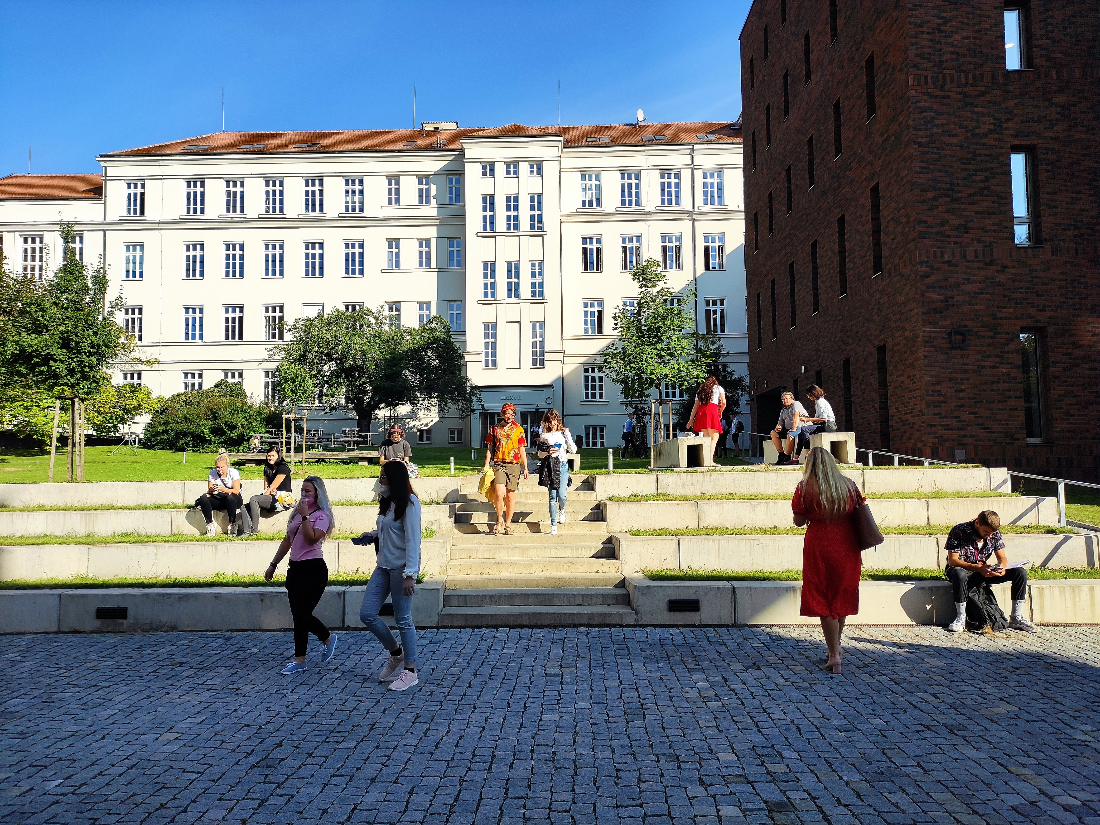

Slide 9
Length of Degree Programs and Important Dates
Bachelor‘s programs: 3 years (6 semesters)
Master‘s programs: 2 years (4 semesters)
PhD programs: 4 years (8 semesters)
Fall semester: September – December
Spring semester: February – May

Slide 10
Studies in English at the Faculty of Arts
Bachelor´s Studies:
English Language and Literature: € 2,500/academic year
Culture, Media and Performative Arts: € 2,500/academic year
Master´s Studies:
English Language and Literature: € 2,500/academic year
North-American Culture Studies: € 2,500/academic year
Visual Cultures and Art History: € 1,250/academic year
Medieval Latin Language and Literature: € 1,250/academic year

Slide 11
Studies in English at the Faculty of Arts
Doctoral Studies:
Educational Sciences: € 2,500/academic year
English Linguistics: € 2,000/academic year
English Linguistics
Experimental and Applied Linguistics
Literatures in English: € 2,000/academic year
Study of Religions: € 500/academic year
Musicology: € 2,500/academic year
Aesthetics and Culture Studies: € 2,500/academic year
Digital Culture and Creative Industries: € 2,500/academic year
Classical Philology: € 2,500/academic year
Comparative Indo-European Linguistics : € 2,000/academic year

Slide 12
The City of Brno
6th most popular student city according to the QS student index
350,000 inhabitants, approx. 60,000 students
Famous for its coffee culture, electron microscopes, functionalist architecture, music and theatre, video games industry and much more
Ideal point for exploring Europe

Slide 13
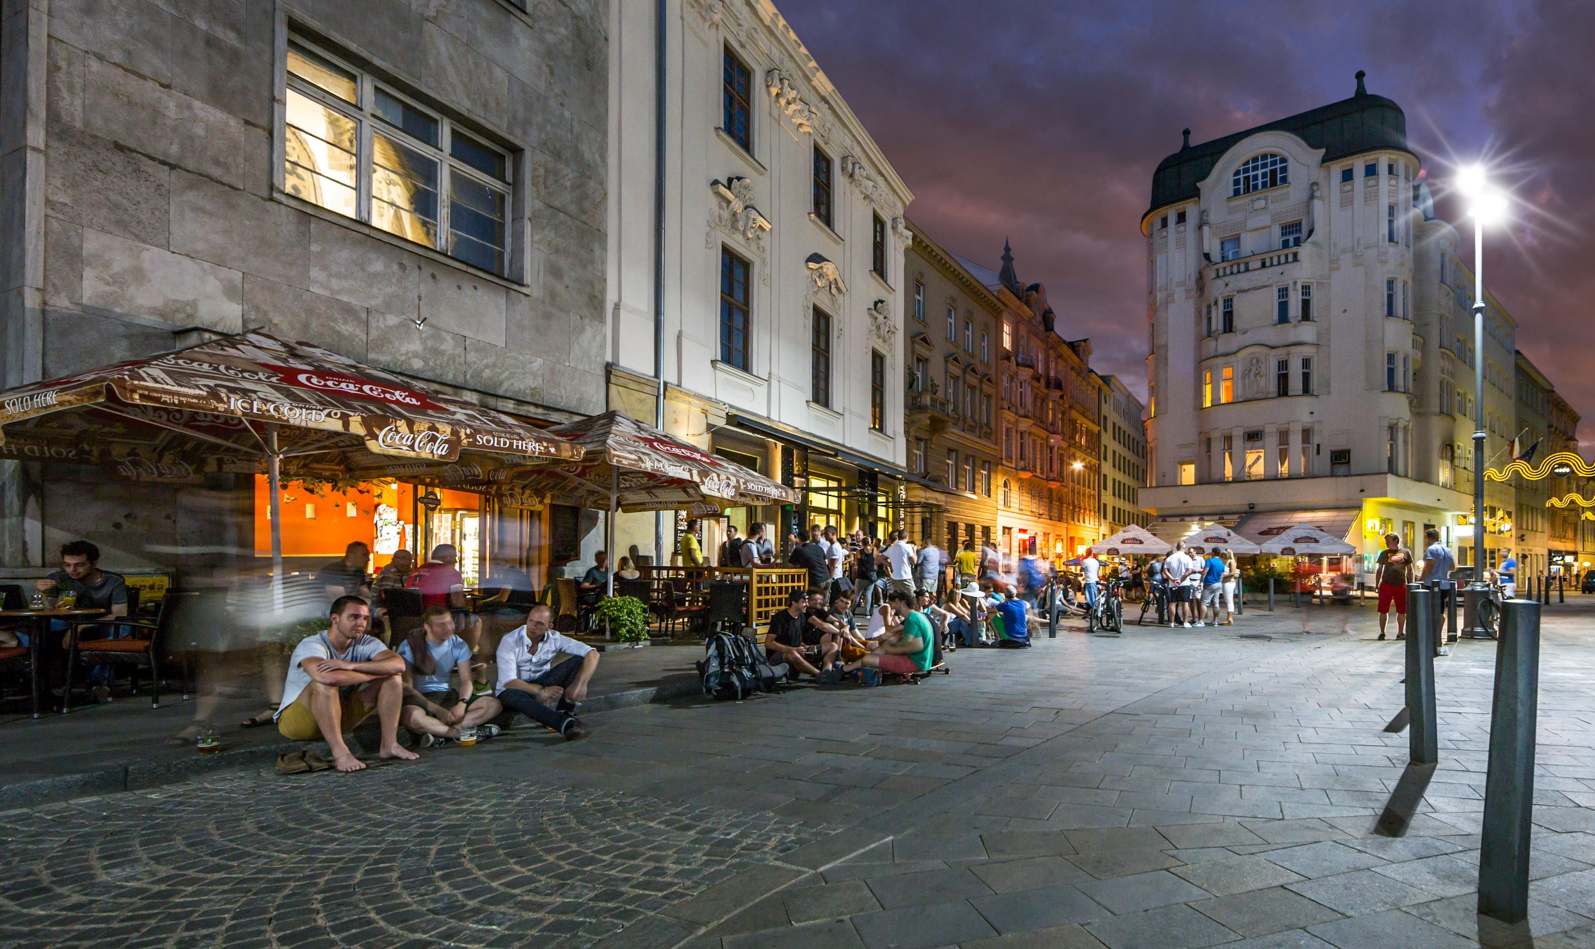
Brno – a student city

Slide 14
Czech Language for Foreigners
Various levels: beginners, pre-intermediate, intermediate, advanced
Various numbers of hours a week: 25 – 4 hours/week, intenstive courses
Various lengths: a year long courses, one semester courses, evening courses, summer school, individual study plans
Prices differ in accordance with the intensity of teaching
Scholarship: 10 three-month scholarships for applicants with a good knowledge of Czech language in order to be able to follow the lectures and attend seminars conducted in Czech

Slide 15
Research at the Faculty of Arts
Research in 2021:
202 projects implemented
Project funding:
Internal research support (116), National providers (78), EU financed projects (7), International funds (1)

Slide 16
Research at the Faculty of Arts
Major projects implemented in 2021:
H2020/ERC:
- Continuity and Rupture in Central European Art and Architecture, 1918-1939 (Rampley Matthew, B.A., Ph.D.)
- Networks of Dissent: Computational Modelling of Dissident and Inquisitorial Cultures in Medieval Europe (Zbíral David, Ph.D. )
H2020 / Marie Skłodowska-Curie Actions:
- Conques in the Global World. Transferring Knowledge: from Material to Immaterial Heritage (Foletti Ivan, prof., MA, Docteur ès Lettres)
International Visegrad Fund:
- Shakespeare in Central Europe after 1989: common heritage and regional identity (Havlíčková Kysová Šárka, M.A., Ph.D.)

Slide 17
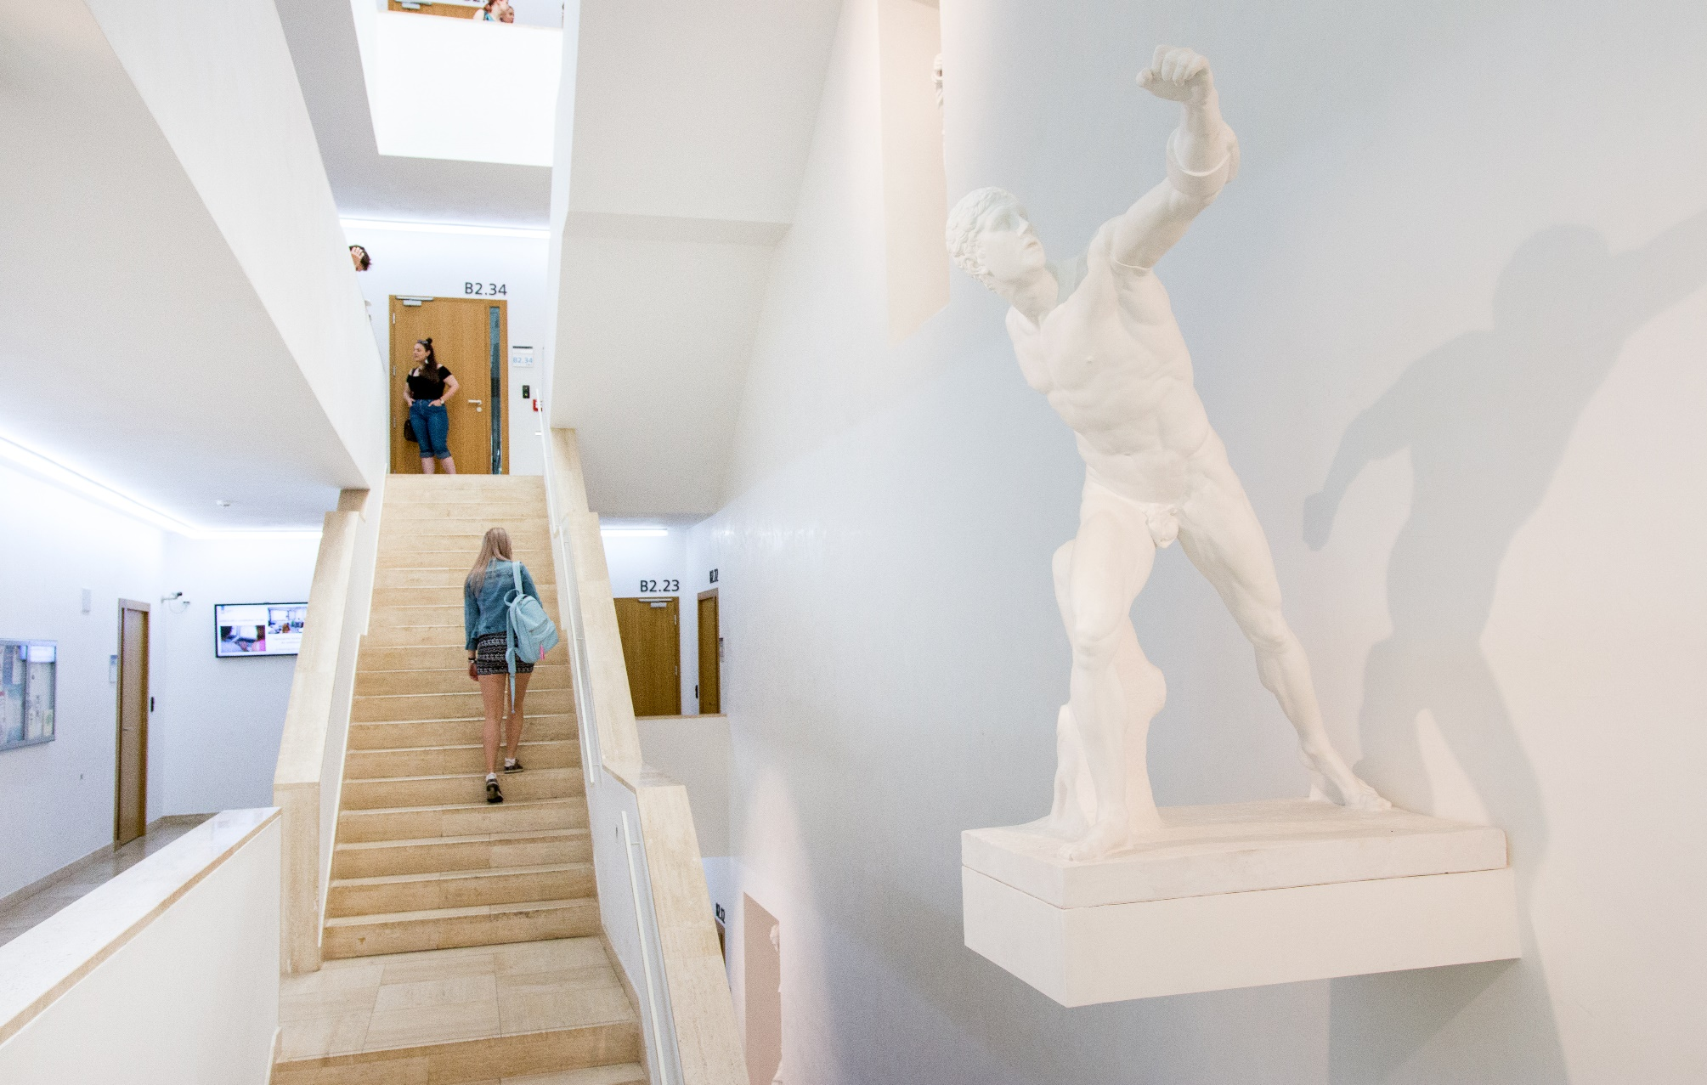
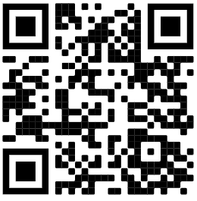
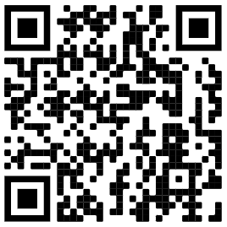
foamuni
FacultyofArtsMasarykUniversity
www.muni.cz www.phil.muni.cz

